Slide 1
Module - 2
IoT Architecture

Slide 2
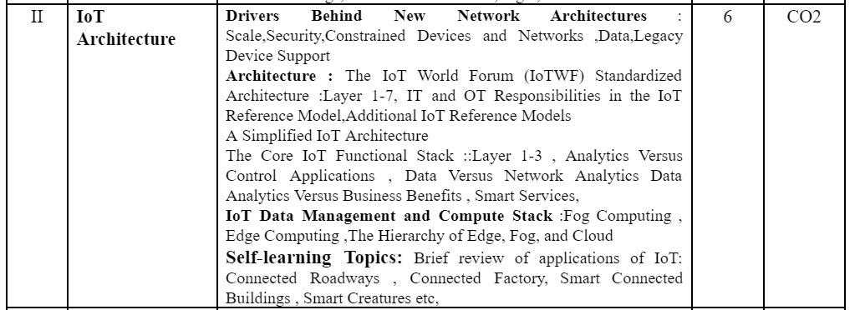
Book :
David Hanes, Gonzalo Salgueiro, Patrick Grossetete, Robert Barton, Jerome Henry, IoT Fundamentals Networking Technologies, Protocols, and Use Cases for the Internet of Things CISCO. (Ch 2)
Blooms level : L1,L2,L3,L4

Slide 3
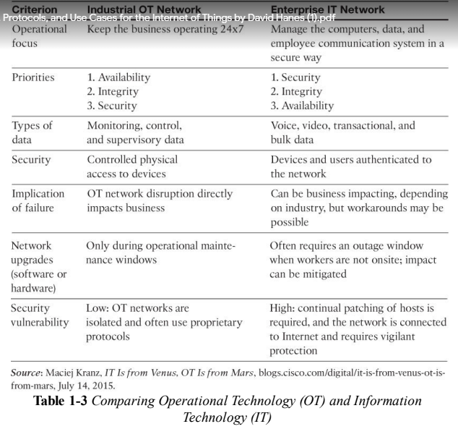

Slide 4
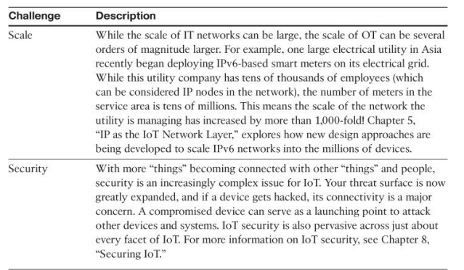
IOT Challenges

Slide 5
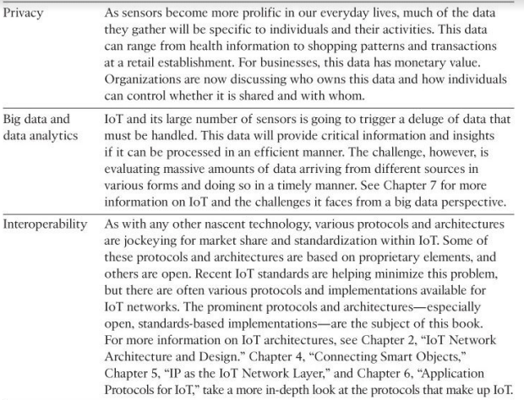

Slide 6
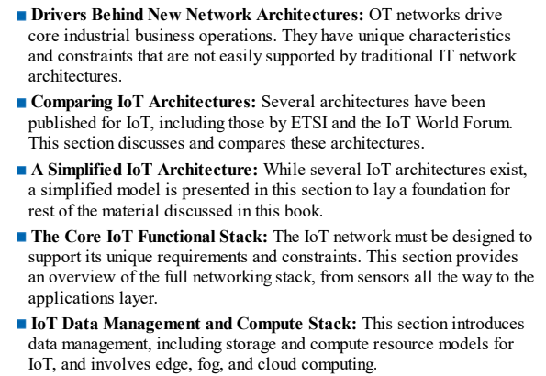
Points to be covered

Slide 7
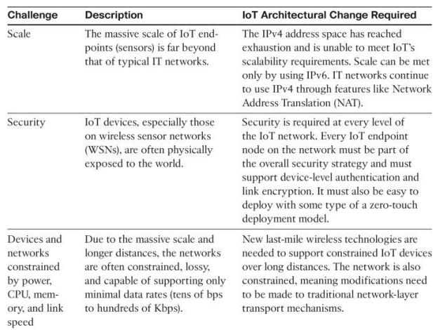
Drivers Behind New Network Architectures

Slide 8
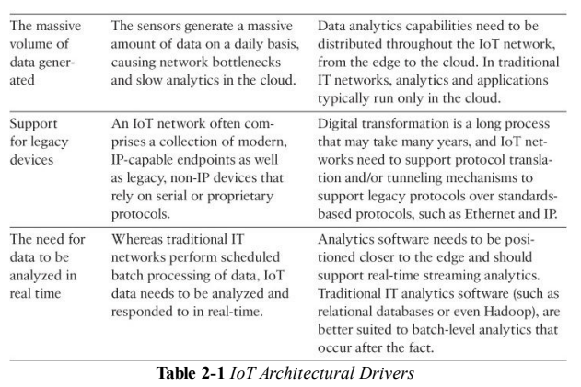

Slide 9
Scale
The scale of a typical IT network is on the order of several thousand devices —typically printers, mobile wireless devices, laptops, servers, and so on.
The traditional three-layer campus networking model, supporting access,distribution, and core (with sub architectures for WAN, Wi-Fi, data center, etc.), is well understood.
But now consider what happens when the scale of a network goes from a few thousand endpoints to a few million.
How many IT engineers have ever designed a network that is intended to support millions of routable IP endpoints?
This kind of scale has only previously been seen by the Tier 1 service providers.
IoT introduces a model where an average-sized utility, factory, transportation system, or city could easily be asked to support a network of this scale.
Based on scale requirements of this order, IPv6 is the natural foundation for the IoT network layer.

Slide 10
Security
For optimum security, IoT systems must: Be able to identify and authenticate all entities involved in the IoT service (that is, gateways, endpoint devices, home networks, roaming networks, service platforms)
Ensure that all user data shared between the endpoint device and back-end applications is encrypted
Comply with local data protection legislation so that all data is protected and stored correctly
Utilize an IoT connectivity management platform and establish rules-based security policies so immediate action can be taken if anomalous behavior is detected from connected devices
Take a holistic, network-level approach to security

Slide 11
Data
IoT devices generate a mountain of data.
In general, most IT shops don’t really care much about the unstructured chatty data generated by devices on the network.
However, in IoT the data is like gold, as it is what enables businesses
to deliver new IoT services that enhance the customer experience,
reduce cost, and
deliver new revenue opportunities.
Therefore, unlike IT networks, IoT systems are designed to stagger data consumption throughout the architecture, both to filter and reduce unnecessary data going upstream and to provide the fastest possible response to devices when necessary.

Slide 12
Legacy Device Support
Supporting legacy devices in an IT organization is not usually a big problem. If someone’s computer or operating system is outdated, she simply upgrades.
If someone is using a mobile device with an outdated Wi-Fi standard, such as 802.11b or 802.11g, you can simply deny him access to the wireless network,and he will be forced to upgrade. In OT systems, end devices are likely to be on the network for a very long time—sometimes decades.
As IoT networks are deployed, they need to support the older devices already present on the network, as well as devices with new capabilities.many of these legacy machines might support older protocols, such as serial interfaces, and use RS-232.
In this case, the IoT network must either be capable of some type of protocol translation or use a gateway device to connect these legacy endpoints to the IoT network.

Slide 13
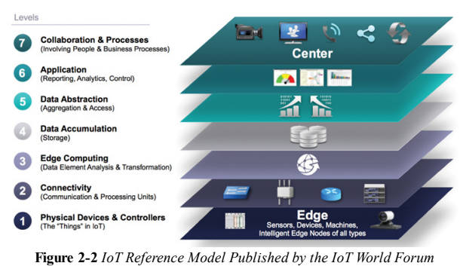
The IoT World Forum (IoTWF) Standardized Architecture
Using
this reference model, we are able to achieve the following:
Decompose the IoT problem into smaller parts
Identify different technologies at each layer and how they relate to one Another
Define a system in which different parts can be provided by different vendors
Have a process of defining interfaces that leads to interoperability
Define a tiered security model that is enforced at the transition points
between levels

Slide 14
Layer 1: Physical Devices and Controllers Layer
Layer 1: Physical Devices and Controllers Layer
The first layer of the IoT Reference Model is the physical devices and controllers layer.
This layer is home to the “things” in the Internet of Things, including the various endpoint devices and sensors that send and receive information.
The size of these “things” can range from almost microscopic sensors to giant machines in a factory.
Their primary function is generating data and being capable of being queried and/or controlled over a network.

Slide 15
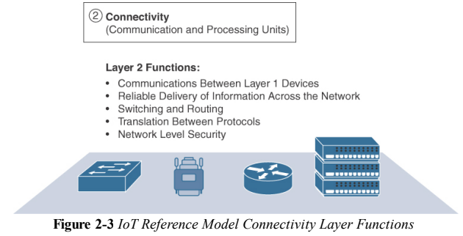
Layer 2: Connectivity Layer

Slide 16
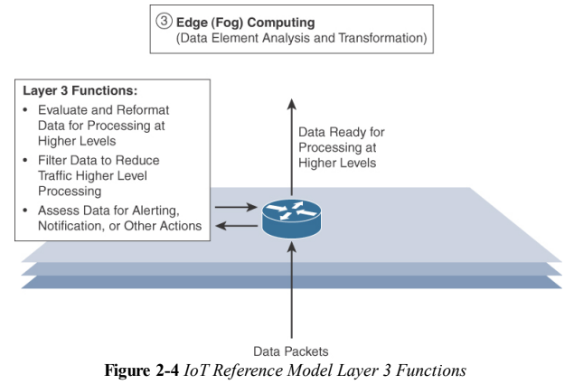
Layer 3: Edge Computing Layer
Edge computing is the role of Layer 3.
Edge computing is often referred to as the “fog” layer a
At this layer, the emphasis is on data reduction and converting network data flows into information that is ready for storage and processing by higher layers.
One of the basic principles of this reference model is that information processing is initiated as early and as close to the edge of the network as possible.

Slide 17
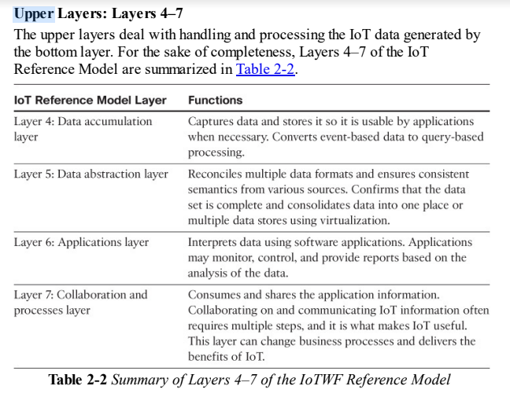

Slide 18
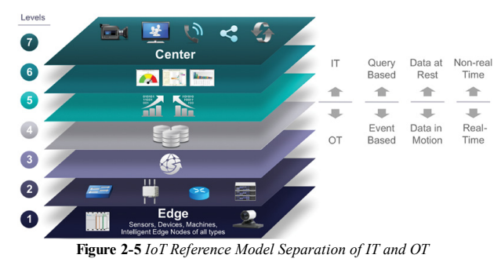
IT and OT Responsibilities in the IoT Reference Model
An interesting aspect of visualizing an IoT architecture this way is that you can start to organize responsibilities along IT and OT lines. Figure 2-5 illustrates a natural demarcation point between IT and OT in the IoT Reference Model framework.

Slide 19
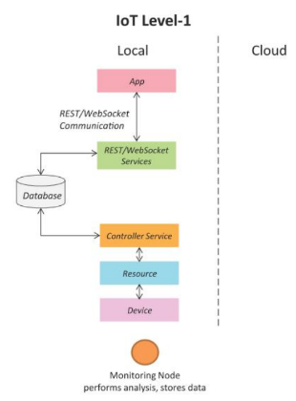

Slide 20
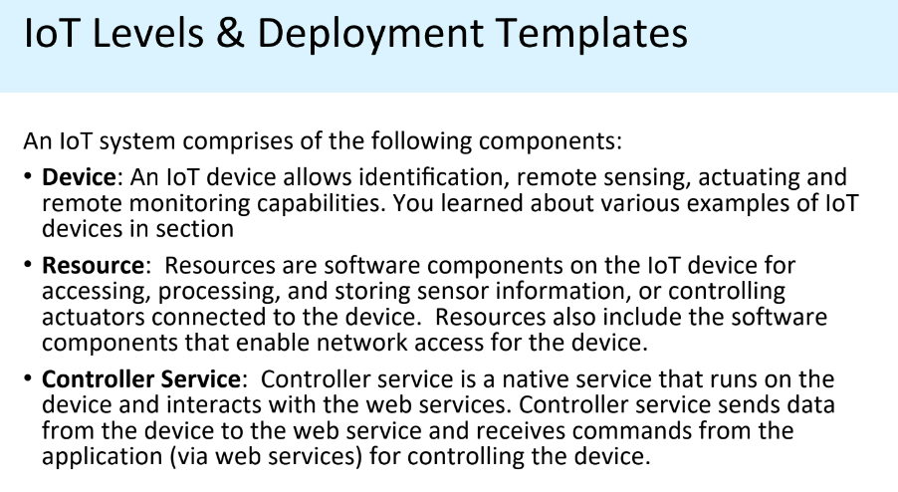

Slide 21
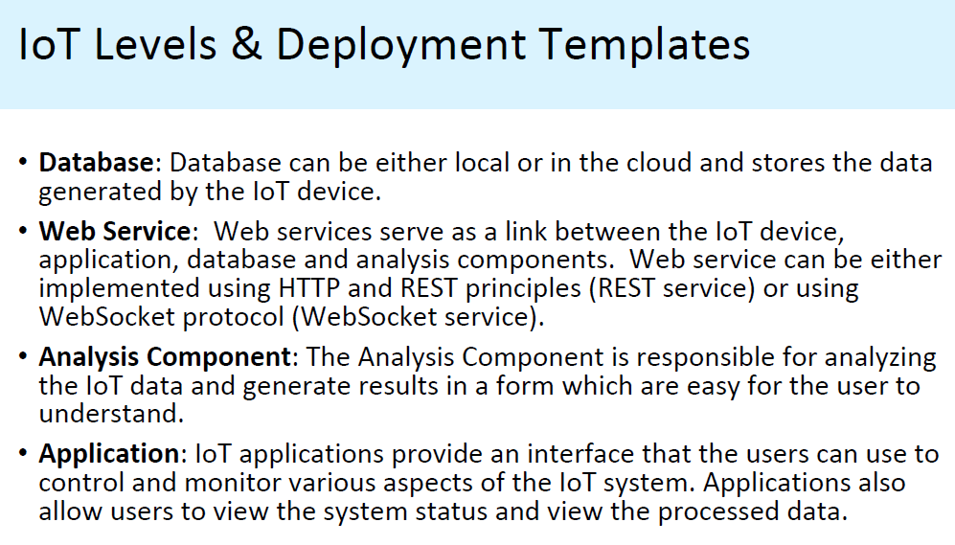

Slide 22
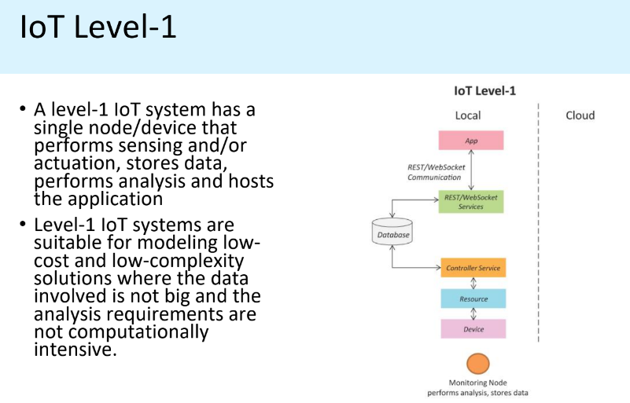
Layers 1, 2
Example: Consider an IOT device that monitors the lights in a house.
The lights are controlled through switches.
Status of each light is maintained in a local database.

Slide 23
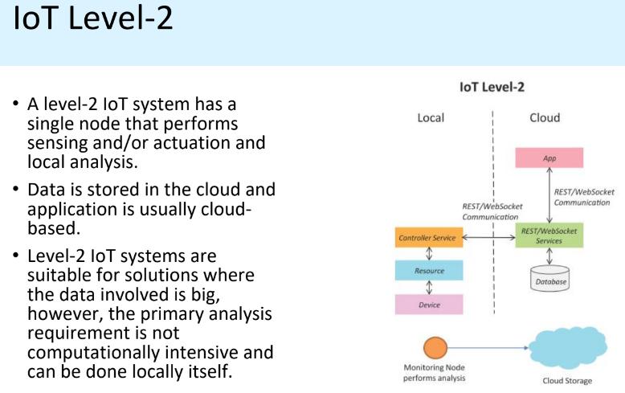
Layers 1, 2, 3 (may or may not) and 4
Ex: A single node monitors the soil moisture in the field.
This is sent to the database on cloud using REST APIs.
Controller service continuously monitors moisture levels.
Node has processing capability

Slide 24
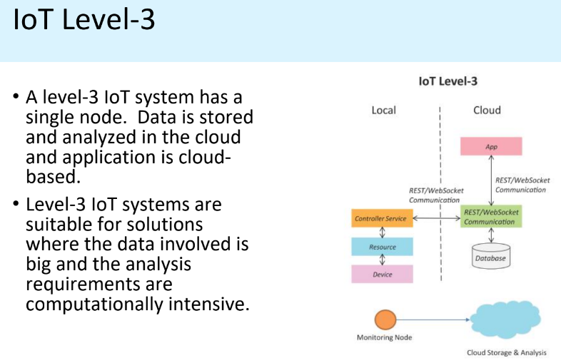
Layers 1 to 6
Example: A node is monitoring a package using devices like accelerometer and gyroscope. Needed to monitor the activity for a longer duration
Analysis/Processing capability shifted to Cloud

Slide 25
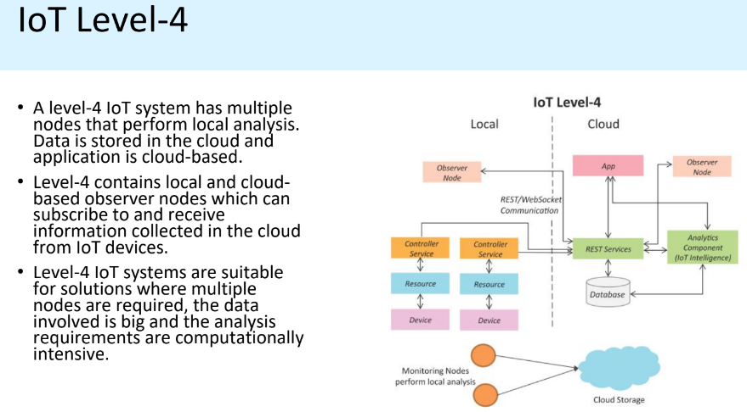
Layers 1 to 6
Observer nodes can process information and use it for applications but do not perform control functions.
Example: Noise monitoring of a area requires various nodes functioning independent of each other.
Each has its own controller service.
Data is stored in cloud database.
Analysis is done on the cloud and the entire IOT system is monitored on the cloud using an application.
Analysis/Processing capability at local level + Topology - one to one
IOT level 4 - Multiple nodes collect information and store in the cloud.
A cloud based application controls the system.
Local and remote observer nodes are present that subscribe to and receive information collected in cloud from various devices.

Slide 26
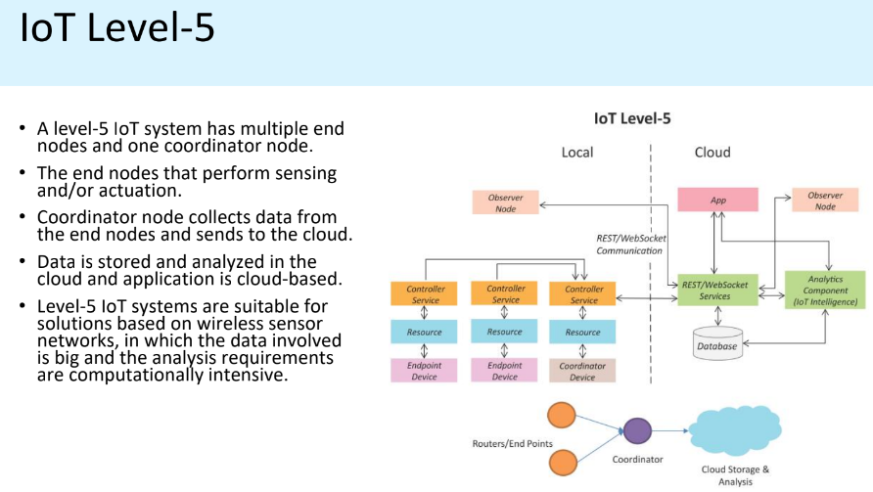
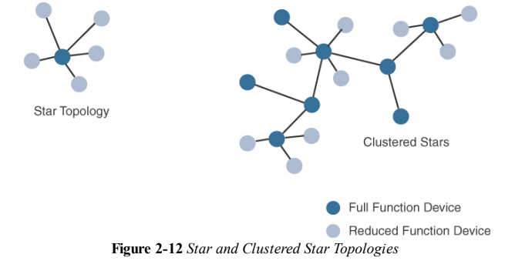
The sensor which can implement a subset of protocol functions to perform just a specialized part (communication with the coordinator). Such a device is called a reduced-function device (RFD).
An RFD cannot be a coordinator. An RFD also cannot implement direct communications to another RFD.
The coordinator that implements the full network functions is called, by contrast, a full-function device (FFD).
Layers 1 to 6
WSN - point to multipoint topology
Example: A monitoring system has various components: end nodes collect various data from the environment and send it to coordinator node.
Coordinator node acts as gateway and allows the data to be transferred to cloud storage using REST API.
Controller service on the coordinator node sends data to the cloud.
IOT level 5-Nodes present locally are of two types : end nodes and coordinator nodes.
End nodes collect data and perform sensing or actuation or both.
Coordinator nodes collect data from end nodes and sends it to cloud.
Data is stored and analysed in cloud and application is cloud based.

Slide 27
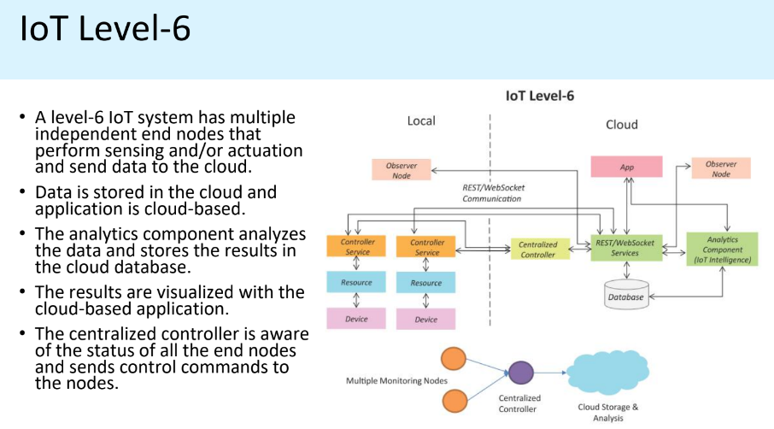
Layers 1 to 6 - Centralized Controller to monitor the status of the node
Example: Weather monitoring consists of sensors that monitor different aspects of a system.
The end nodes send data to cloud storage.
Analysis component, application and storage are in cloud.
Centralized controller controls all nodes and provides inputs.
IOT level 6- Multiple independent end nodes perform sensing and actuation and send data to cloud.
Data is stored in cloud and application is cloud based. The analytics components analyses the data and stores the results in the cloud database.
The results are visualized with cloud based application. The centralized controller is aware of the status of all the end nodes and sends control commands to the node.

Slide 28
Additional IoT Reference Models
In addition to the two IoT reference models already presented in this chapter,
several other reference models exist. These models are endorsed by various
organizations and standards bodies and are often specific to certain industries
or IoT applications. Table 2-3 highlights these additional IoT reference
models.

Slide 29
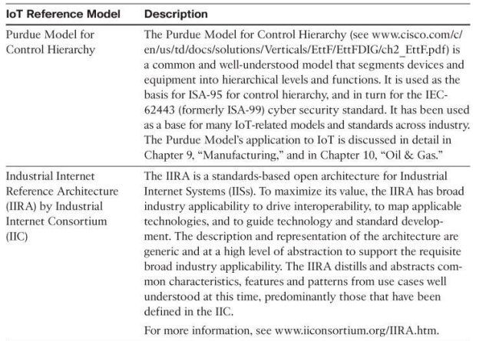
International Society of Automation

Slide 30
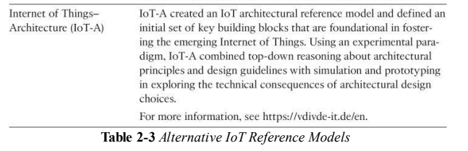

Slide 31
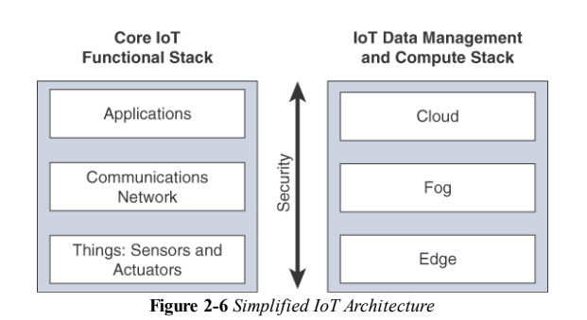
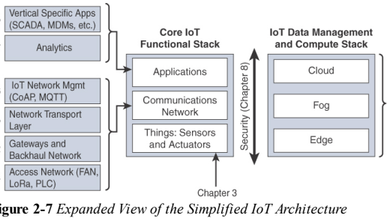
A Simplified IoT Architecture
In a hierarchical telecommunications network, the backhaul portion of the network comprises the intermediate links between the core network, or backbone network, and the small subnetworks at the edge of the network.

Slide 32
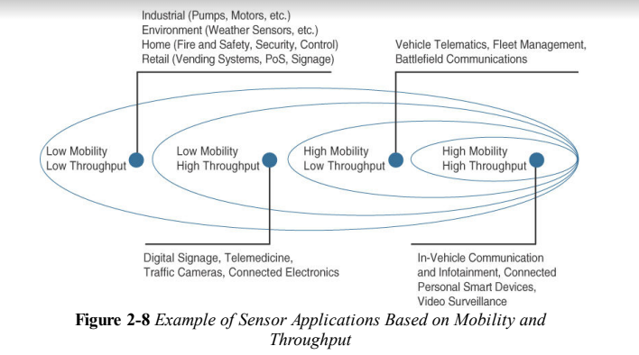
Layer 1: Things: Sensors and Actuators Layer
Battery-powered or power-connected:
Mobile or static: Low or high
reporting frequency: Simple or rich data:
Report range:Object density per cell:

Slide 33
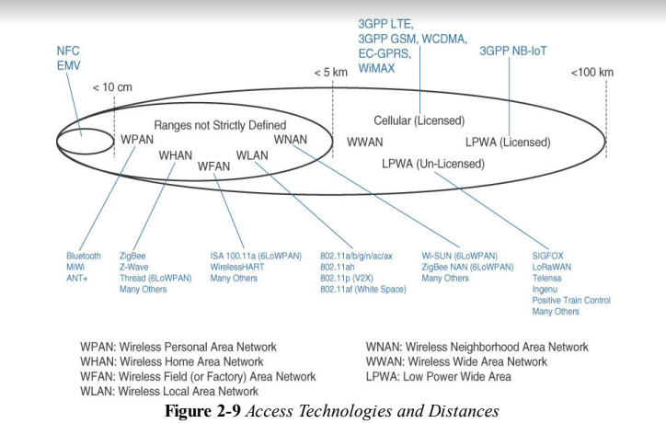
Layer 2: Communications Network Layer
Near Field Communication
Europay, Mastercard and Visa

Slide 34
Communication topologies:
Some technologies offer flexible connectivity structure to extend communication possibilities
1.Point-to-point topologies: These topologies allow one point to communicate with
another point.
several technologies are referred to as “point-to-point” when each object establishes an individual session with the gateway
2. Point-to-multipoint topologies: These topologies allow one point to communicate with more than one other point.
Most IoT technologies where one or more than one gateways communicate with multiple smart objects are in this category
The sensor which can implement a subset of protocol functions to perform just a specialized part (communication with the coordinator). Such a device is called a reduced-function device (RFD).
An RFD cannot be a coordinator. An RFD also cannot implement direct communications to another RFD.
The coordinator that implements the full network functions is called, by contrast, a full-function device (FFD).

Slide 35
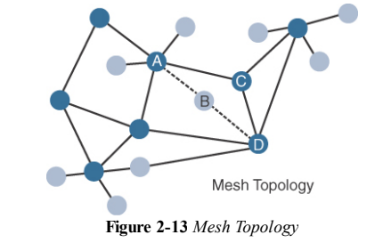
Topologies

Slide 36
LAYER 3: APPLICATIONS AND ANALYTICS LAYER
• Once connected to a network, our smart objects exchange information with other systems.
• From an architectural standpoint, basic classification can be as follows:
Analytics Versus Control Applications
Data Versus Network Analytics
Analytics Application
This type of application collects data from multiple smart objects, processes the collected data, and displays information resulting from the data that was processed.
The display can be about any aspect of the IoT network, from historical reports, statistics, or trends to individual system states.
Control Application
This type of application controls the behaviour of the smart object or the behaviour of an object related to the smart object.
For ex : a pressure sensor may be connected to a pump

Slide 37
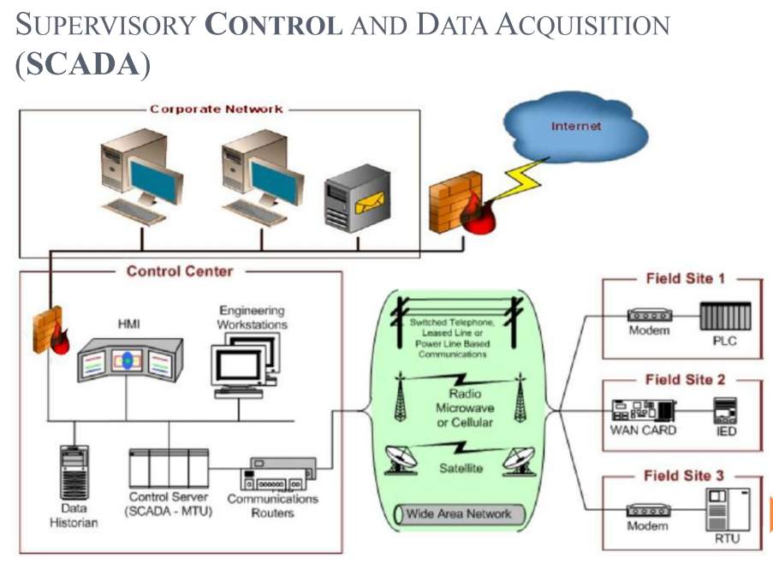
An example of control system architecture is SCADA.
SCADA was developed as a universal method to access remote systems and send instructions.
One example where SCADA is widely used is in the control and monitoring of remote terminal units (RTUs) on the electrical distribution grid.
Layer_7-application
Network Analytics
Data Analytics
Layer_1- sensors and actuators
Layer_6-application
Layer_2&3:connectivity and edge computing
Analytics application
Control Application
Layer_5-data abstraction
Control Application
Layer_4-data acquisition
Layer_2-connectivity and edge computing

Slide 38
DATA VERSUS NETWORK ANALYTICS
Data analytics:This type of analytics processes the data collected by smart objects and combines it to provide an intelligent view related to the IoT system.
Network analytics: Most IoT systems are built around smart objects connected to the network
A loss or degradation in connectivity is likely to affect the efficiency of the system. Such a loss can have dramatic effects.

Slide 39
IOT DATA MANAGEMENT AND COMPUTE STACK
The massive scale of IoT networks is fundamentally driving new architectures. As per the projections by Cisco nearly 50 billion devices will be connected to the IoT networks by the year 2020.
In fact, the data generated by IoT sensors is one of the single biggest challenges in building an IoT system.
In the case of modern IT networks, the data sourced by a computer or server is typically generated by the client/server communications model, and it serves the needs of the application.
In sensor networks, the vast majority of data generated is unstructured and of very little use on its own.
In most cases, the processing location is outside the smart object. A natural location for this processing activity is the cloud.
Smart objects need to connect to the cloud, and data processing is centralized.
One advantage of this model is simplicity. Objects just need to connect to a central cloud application.
This model also has some limitations.
The data volume increases with more number of smart objects being connected to the network which in turn creates a new requirements.

Slide 40
These new requirements include the following
1. Minimizing latency
2. Conserving network bandwidth
3. Increasing local efficiency

Slide 41
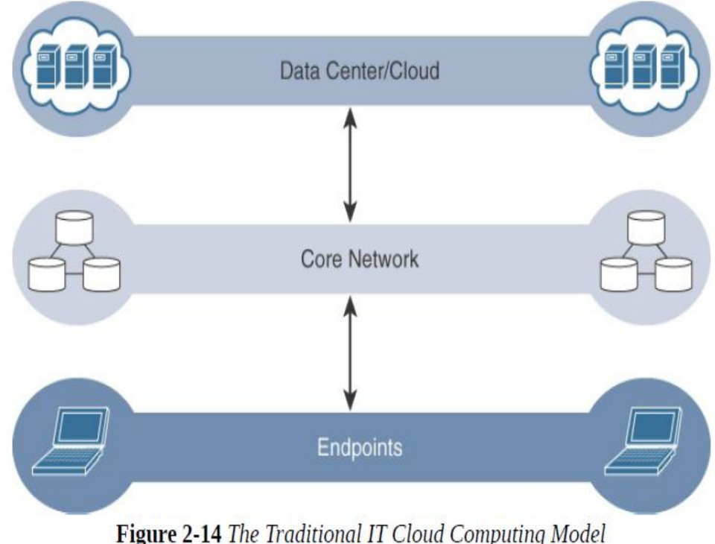

Slide 42
IoT systems function differently. Several data-related problems need to be addressed:
1. Bandwidth in last-mile IoT networks is very limited.
2. Latency can be very high.
3. Network backhaul from the gateway can be unreliable and often depends on 3G/LTE or even satellite links
4. The volume of data transmitted over the backhaul can be high, and much of the data may not really be that interesting(such as simple polling messages).
5. Big data is getting bigger.
6. The concept of storing and analyzing all sensor data in the cloud is impractical.

Slide 43
Fog Computing
The solution to the challenges encountered in data management is
to distribute data management throughout the IoT system,
as close to the edge of the IP network as possible.
The best-known embodiment of edge services in IoT is fog computing.
Fog node: Any device with computing, storage, and network connectivity can be a fog node.
Examples include industrial controllers, switches, routers, embedded servers, and IoT gateways

Slide 44
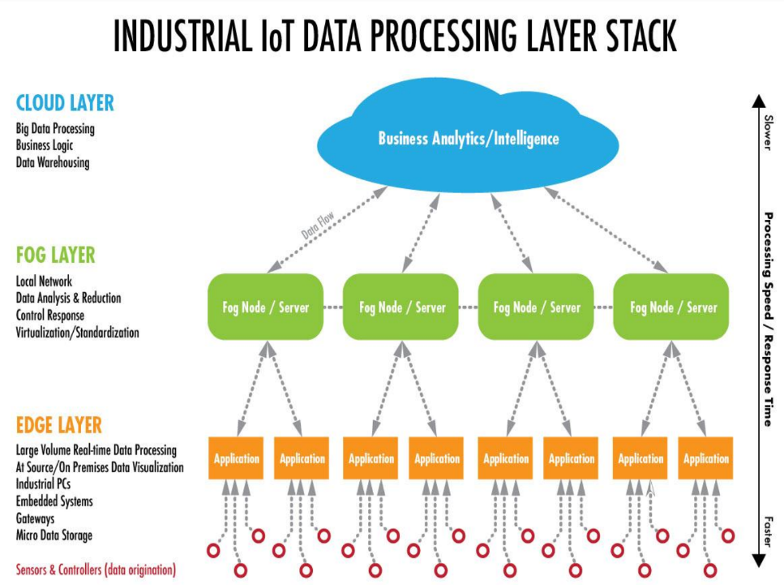

Slide 45
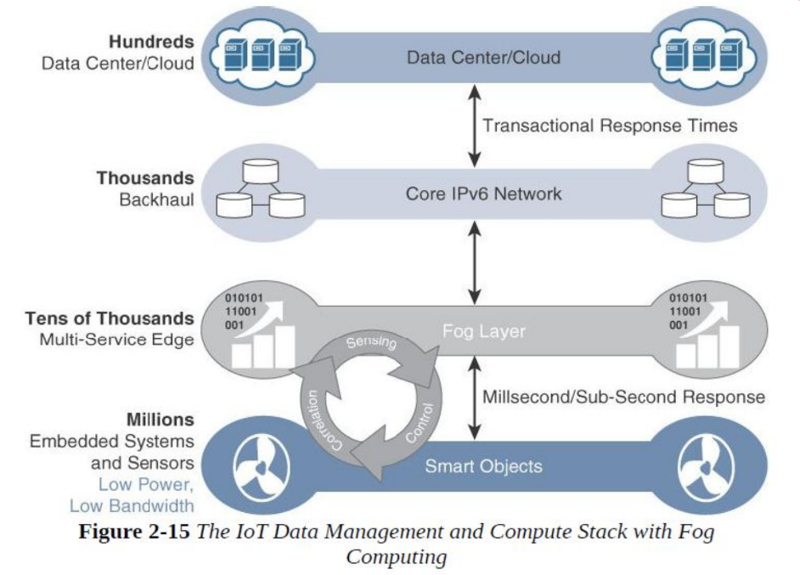

Slide 46
Characteristic of fog computing
The characteristic of fog computing are as follows:
1. Contextual location awareness and low latency
2. Geographic distribution
3. Deployment near IoT endpoints
4. Wireless communication between the fog and the IoT endpoint
5. Use for real-time interactions

Slide 47
EDGE COMPUTING
Edge computing as “a part of a distributed computing topology in which information processing is located close to the edge – where things and people produce or consume that information.”
Edge compute – capable meters are able to communicate with each other to share information on small subsets. -example - smart meters/smart devices
Edge computing is also sometimes called “mist” computing.

Slide 48
The Core IoT Functional Stack
IoT networks are built around the concept of “things,” or smart objects performing functions and delivering new connected services. These objects are “smart” because they use a combination of contextual information and configured goals to perform actions. These actions can be self-contained (that is, the smart object does not rely on external systems for its actions); however, in most cases, the “thing” interacts with an external system to report information that the smart object collects, to exchange with other objects, or to interact with a management platform. In this case, the management platform can be used to process data collected from the smart object and also guide the behavior of the smart object. From an architectural standpoint, several components have to work together for an IoT network to be operational: “Things” layer: At this layer, the physical devices need to fit the constraints of the environment in which they are deployed while still being able to provide the information needed.

Slide 49
Communications network layer:
Communications network layer: When smart objects are not self- contained, they need to communicate with an external system. In many cases, this communication uses a wireless technology. This layer has four sublayers:
Access network sublayer: The last mile of the IoT network is the access network. This is typically made up of wireless technologies such as 802.11ah, 802.15.4g, and LoRa. The sensors connected to the access network may also be wired.
Gateways and backhaul network sublayer: A common communication system organizes multiple smart objects in a given area around a common gateway. The gateway communicates directly with the smart objects. The role of the gateway is to forward the collected information through a longer-range medium (called the backhaul) to a headend central station where the information is processed. This information exchange is a Layer 7 (application) function, which is the reason this object is called a gateway. On IP networks, this gateway also forwards packets from one IP network to another, and it therefore acts as a router.
Network transport sublayer: For communication to be successful,network and transport layer protocols such as IP and UDP must be implemented to support the variety of devices to connect and media to use.
IoT network management sublayer: Additional protocols must be in place to allow the headend applications to exchange data with thesensors. Examples include CoAP and MQTT.

Slide 50
Application and analytics layer:
At the upper layer, an application
needs to process the collected data, not only to control the smart objects
when necessary, but to make intelligent decision based on the
information collected and, in turn, instruct the “things” or other systems
to adapt to the analyzed conditions and change their behaviors or
parameters.

Slide 51
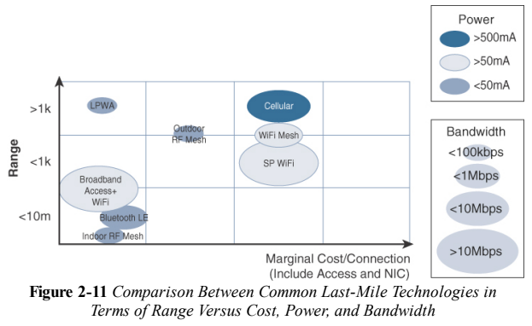

Slide 52
